Slide 1
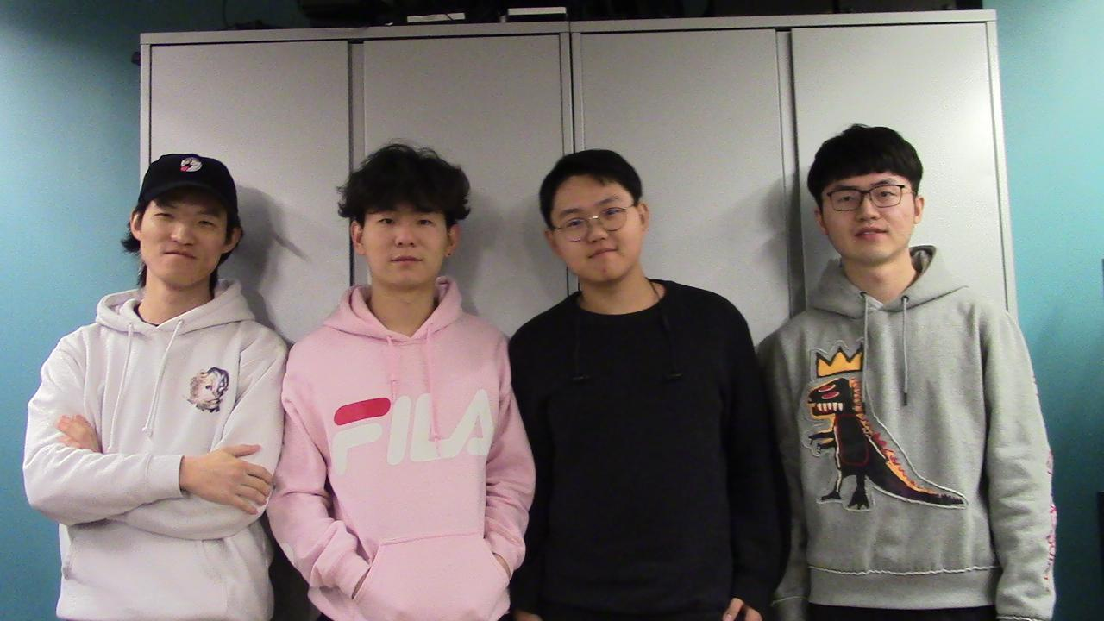

ECE477 MIDTERM DESIGN REVIEW: TEAM 17 Face Tracking Drone

Slide 2
OUTLINE
Project Overview
Major Components
Block Diagram
Packaging Design
Electrical Schematic
PCB Layout
Prototyping Progress
Software Development Status
Project Timeline
Questions

Slide 3
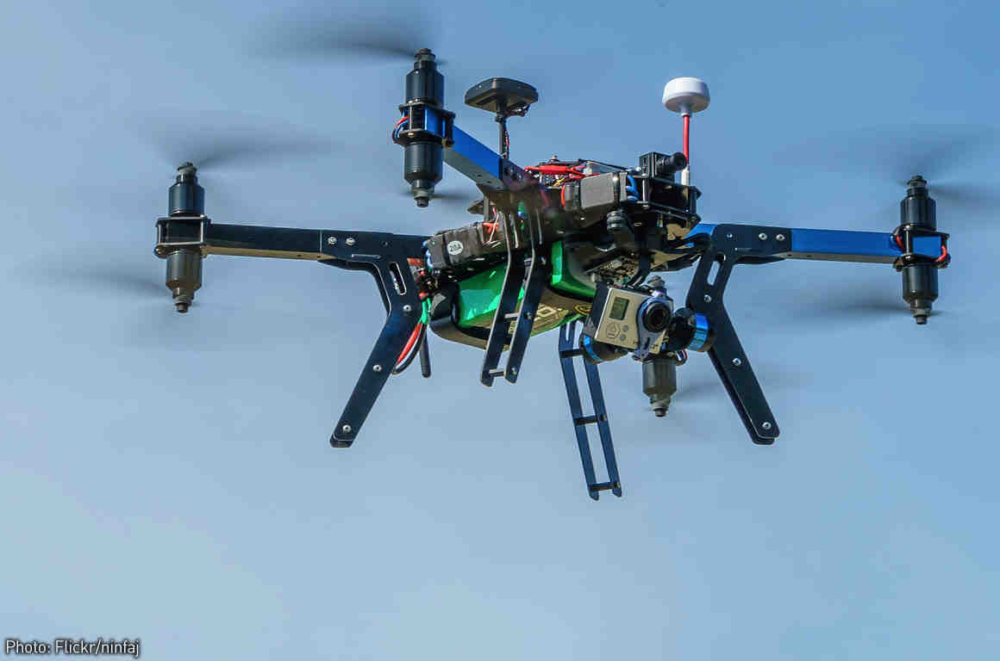
PROJECT OVERVIEW
Our project is a face recognizing drone which follows a person’s movement and records video.
Our drone is unique since it can analyze a person’s head pose and eye gaze direction and adjusts its own position in the air.

Slide 4
PSSCS
PSSC #1: An ability to communicate with flight control to perform desired movement such as moving in a specified direction for a certain distance.
PSSC #2: An ability to communicate over RF/WiFi with the local host to receive commands so that the drone would perform the corresponding action/movement based on the commands.
PSSC #3: An ability to control the gimbal on the quadcopter to point to a specific human face.
PSSC #4: An ability to track face in the video and reach a reasonable framerate(above 30 fps).
PSSC #5: An ability to detect one face precisely in a any given image frame.

Slide 5
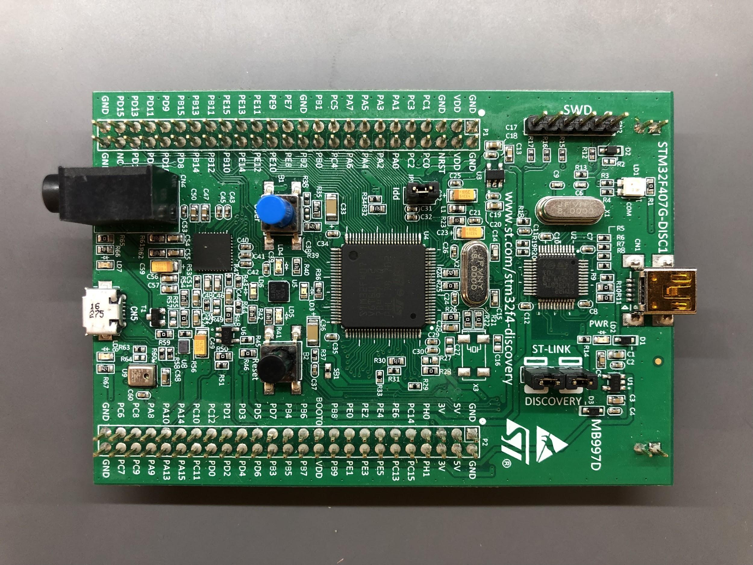
MAJOR COMPONENTS
Microcontroller
STM32F407VG
ARM® Cortex®-M4 32-bit core
1-Mbyte Flash memory
1 SPI channel
1 UART channel
2 DAC channels
1 PWM channel
Several Timers

Slide 6
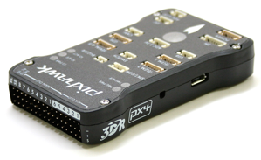
MAJOR COMPONENTS
Flight Controller --- Pixhawk
The Pixhawk 1 autopilot is a popular general purpose flight controller based on the Pixhawk-project FMUv2 open hardware design.
Main System-on-Chip: STM32F427
PPM
8x PWM with manual override
Compass included with the package
Supports Ground Station APM Planner and Mission Planner

Slide 7
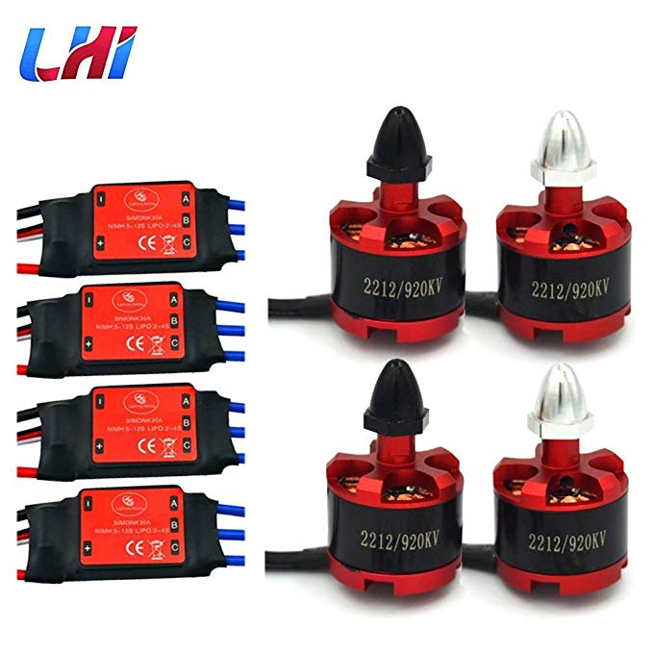
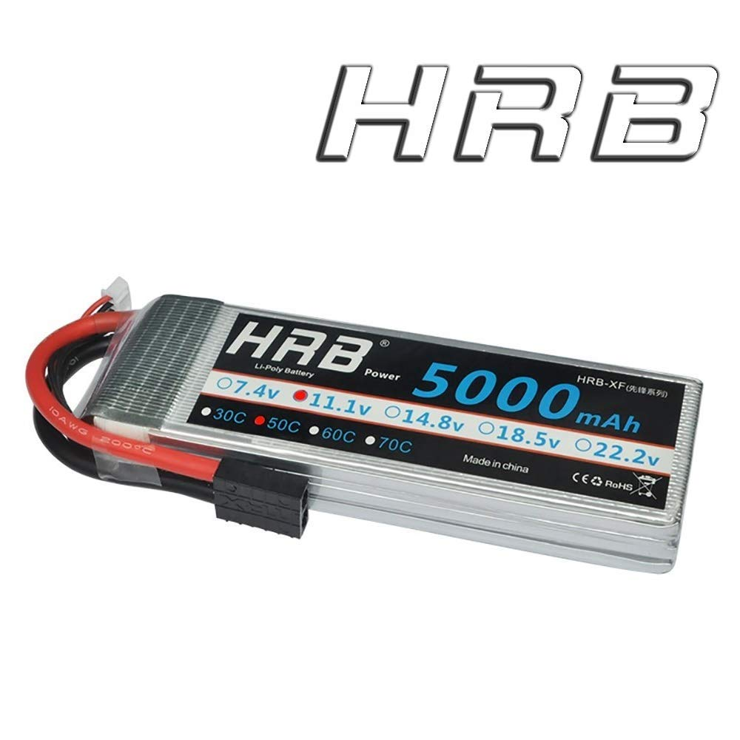
MAJOR COMPONENTS
ESC, Motors and Battery
LHI 4x 2212 920KV Brushless Motor
4x SIMONK 30A ESC
Designed for large propellers which is good for heavy lifting
5000 mAh,11.1V Lipo Battery, 50C-100C

Slide 8
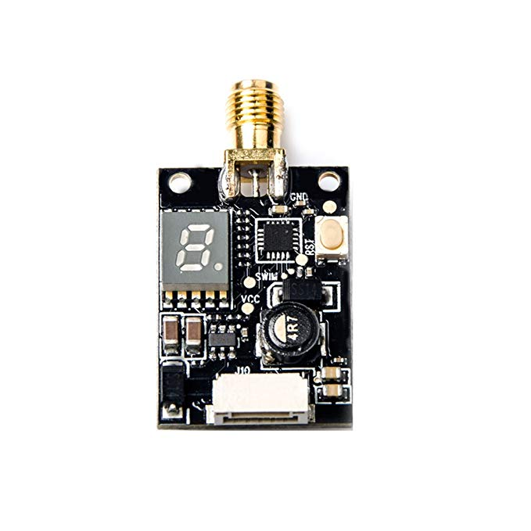
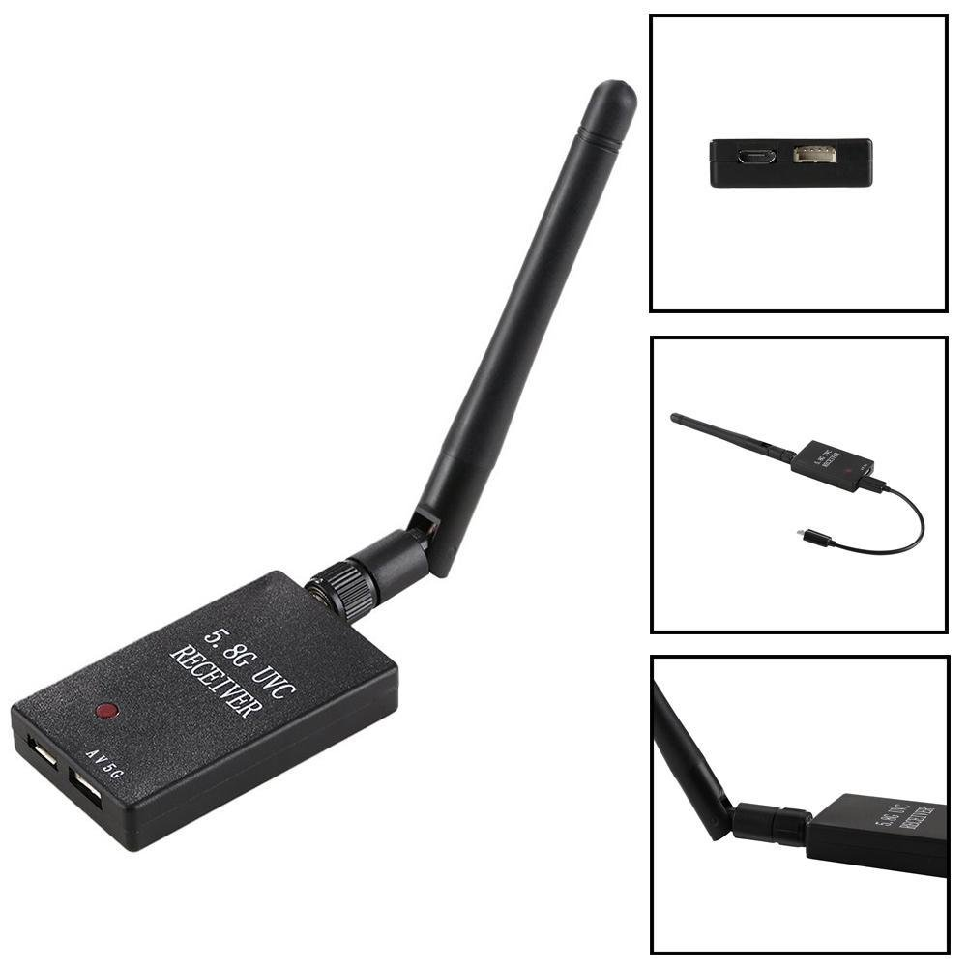
MAJOR COMPONENTS
VTX transmitter and Receiver
25mW/200mW/600mW Switchable FPV Transmitter, 40CH cover A,b,E,F,r bands are compatible with more FPV equipment
5.8GHz Receiver, 150CH, with USB connection compatible
Both can be powered by a 11.1V battery

Slide 9
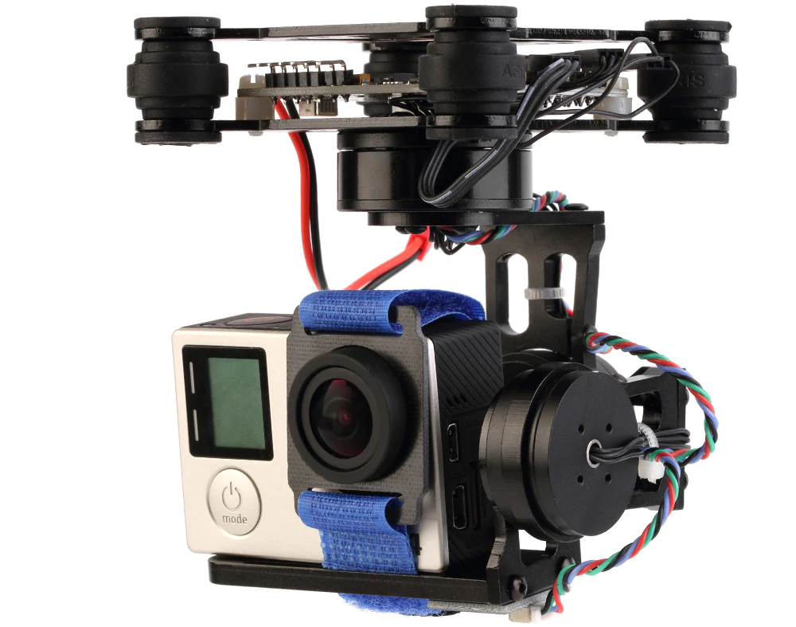
MAJOR COMPONENTS
Gimbal
3-Axis
Open source
Compatible with 12v
Easy interface

Slide 10
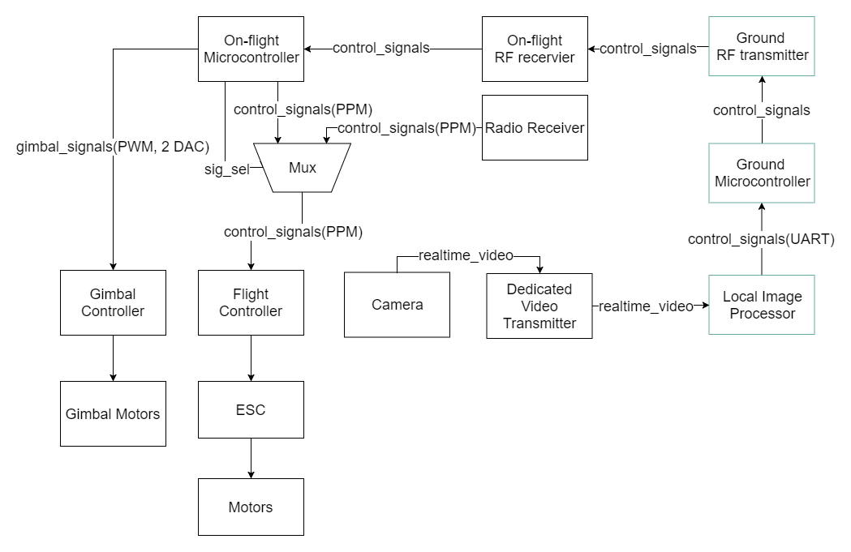
BLOCK DIAGRAM(to revise)

Slide 11
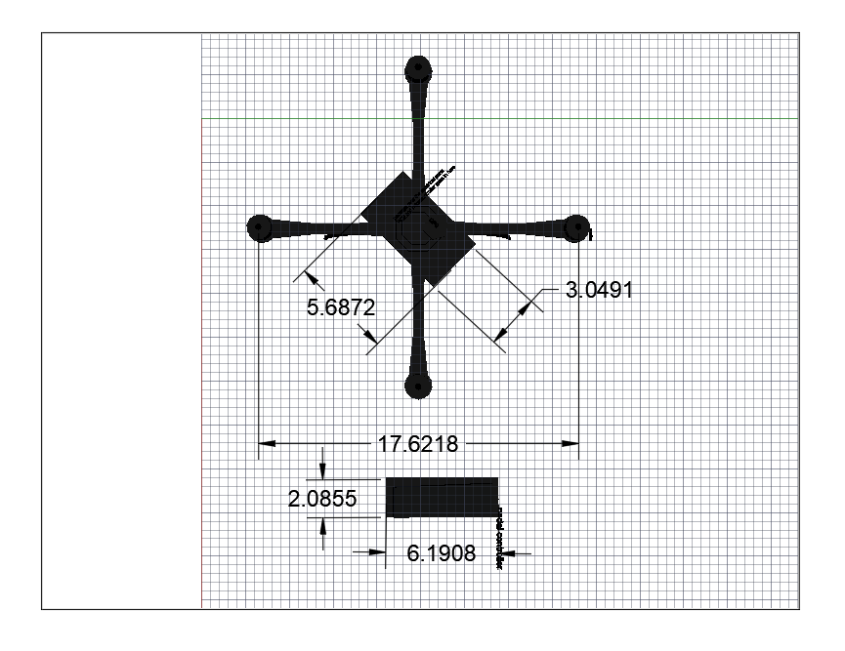
PACKAGING DESIGN
Top view of Model
3D printed packaging for drone and pedal controller
3D printed plastic pieces will be screwed together

Slide 12
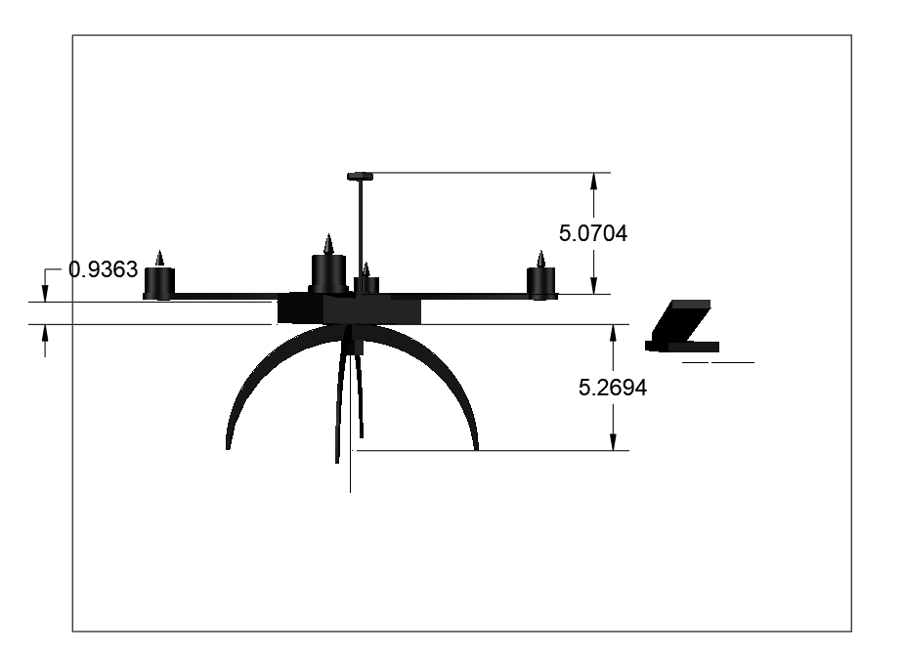
PACKAGING DESIGN
Side view of Model

Slide 13
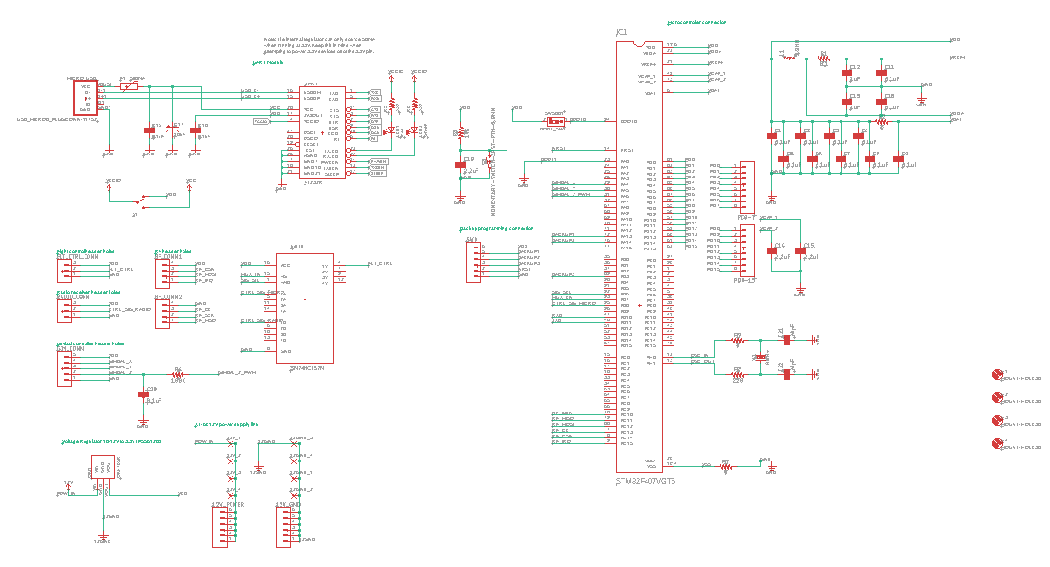
ELECTRICAL SCHEMATIC
Schematic of the on-drone PCB

Slide 14
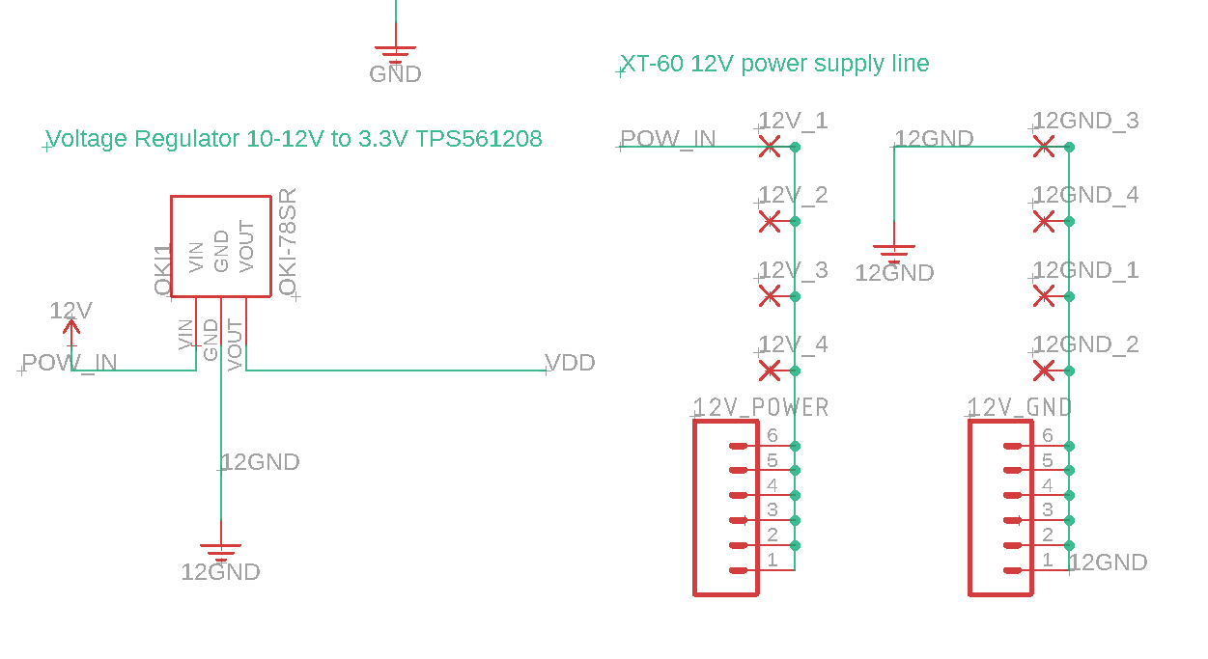
ELECTRICAL SCHEMATIC
Voltage Regulator

Slide 15
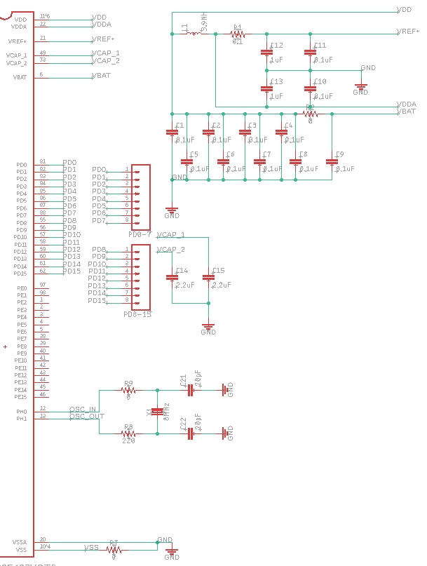
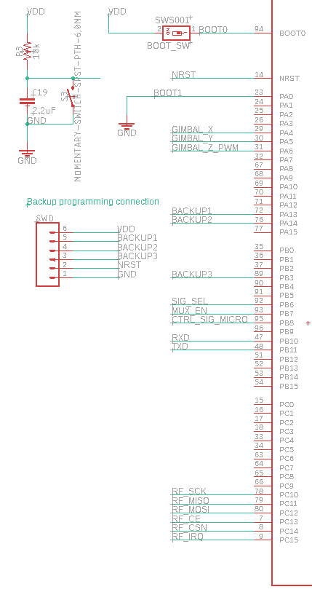
ELECTRICAL SCHEMATIC
Microcontroller Connection

Slide 16
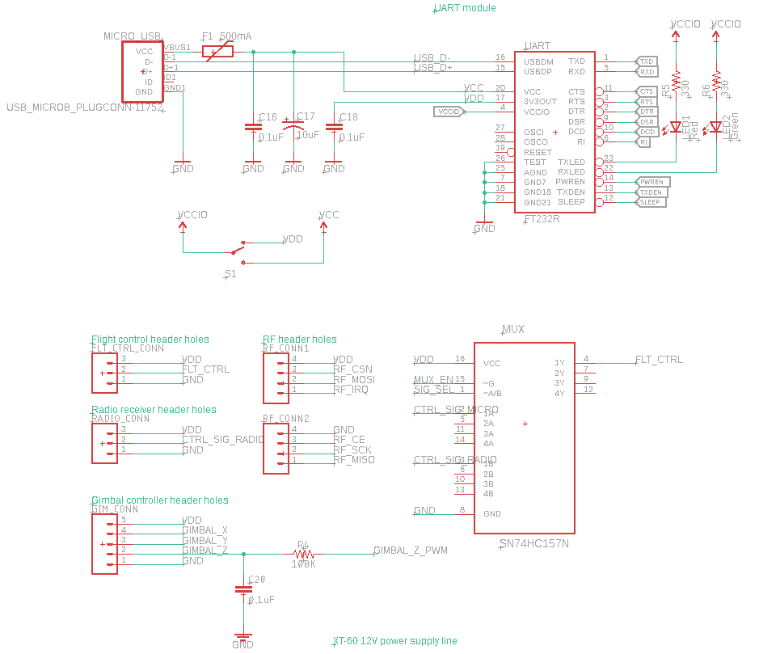
ELECTRICAL SCHEMATIC
Peripherals

Slide 17
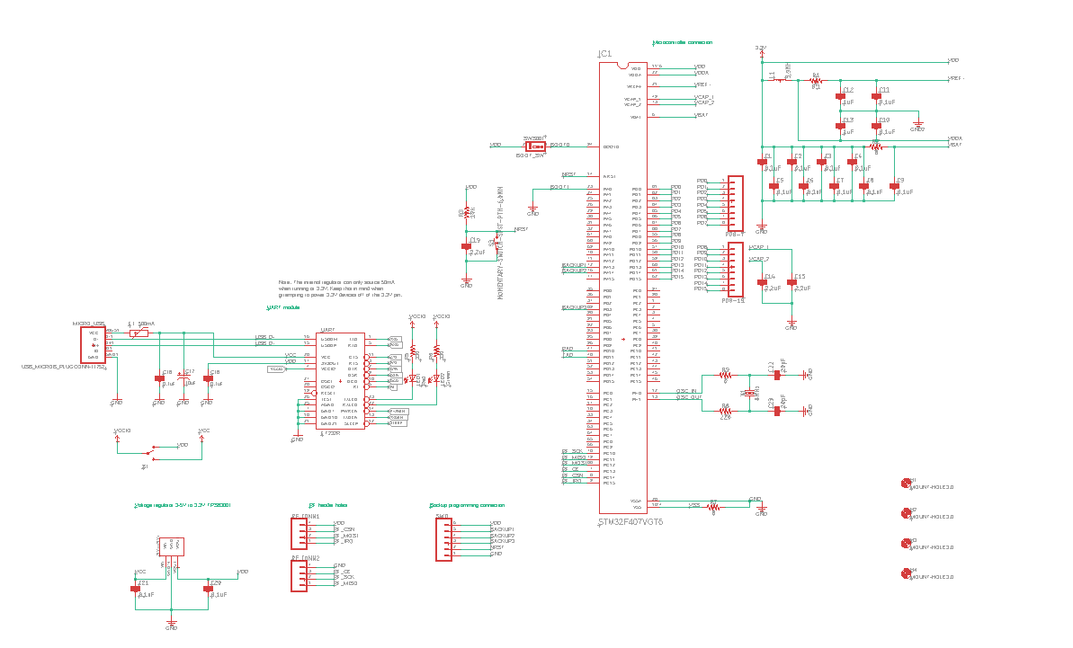
ELECTRICAL SCHEMATIC
Schematic of the Ground Signal Transmitting Board

Slide 18
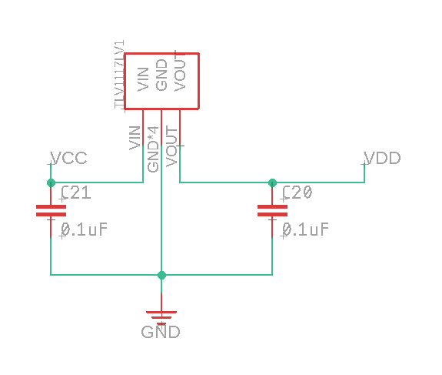
ELECTRICAL SCHEMATIC
Voltage Regulator

Slide 19
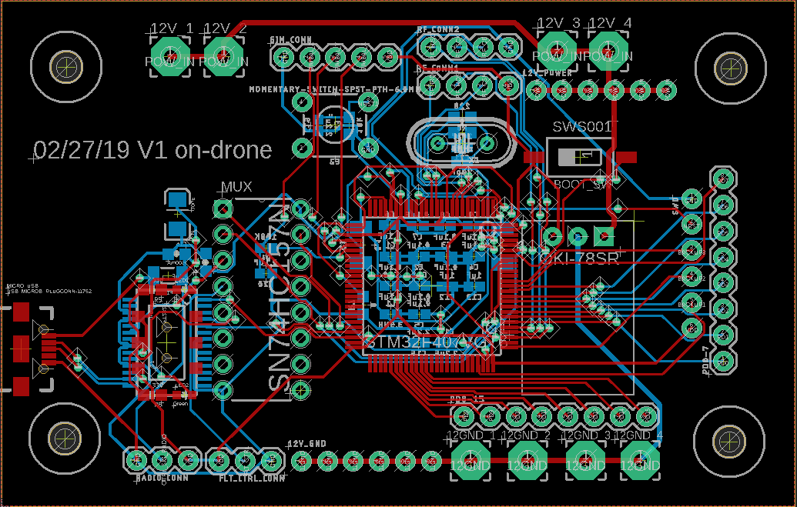
PCB LAYOUT
Layout of the on-drone PCB

Slide 20
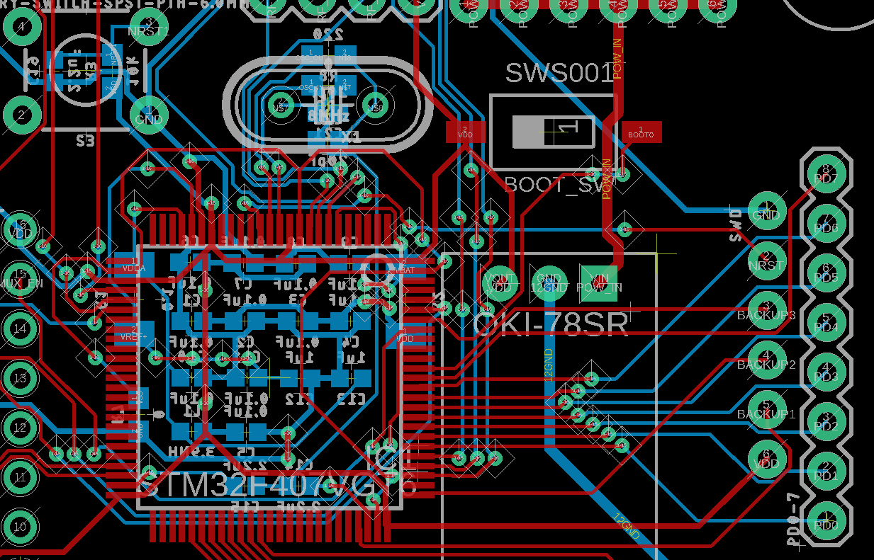
PCB LAYOUT
Layout of the on-drone PCB

Slide 21
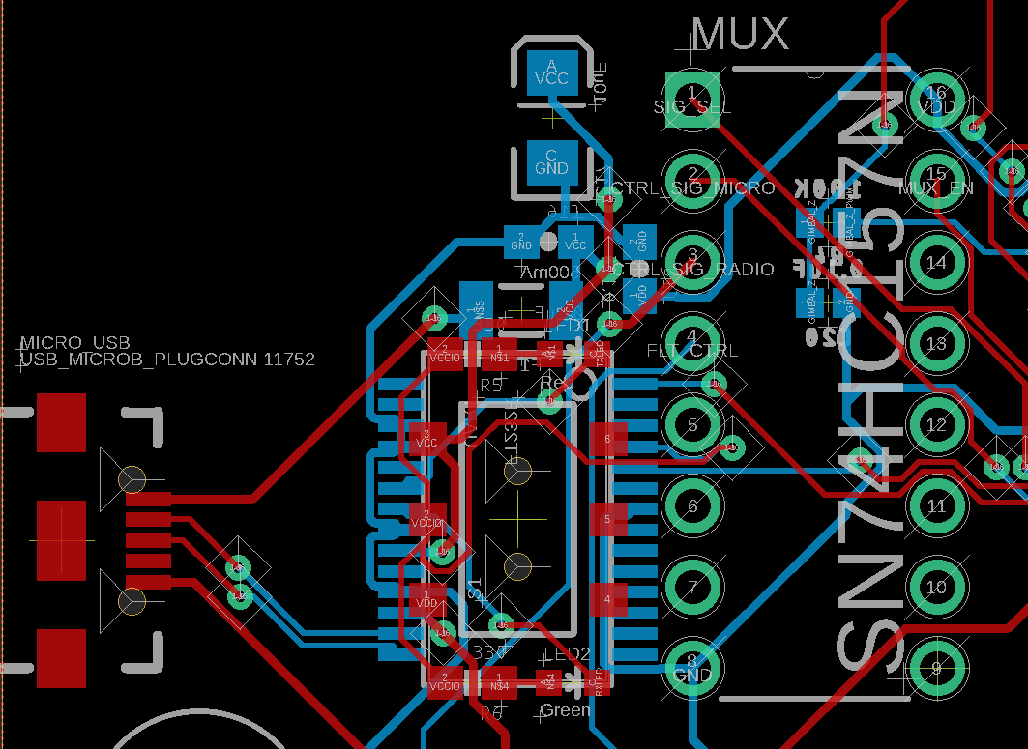
PCB LAYOUT
Layout of the on-drone PCB

Slide 22
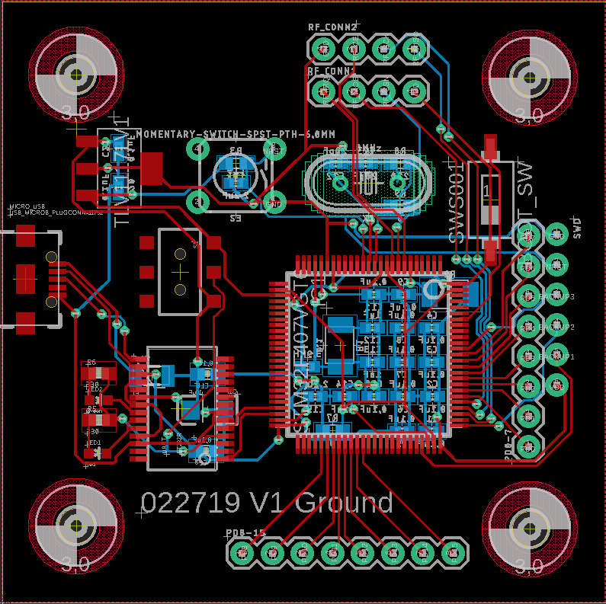
PCB LAYOUT
Layout of the Ground Signal Transmitting Board

Slide 23
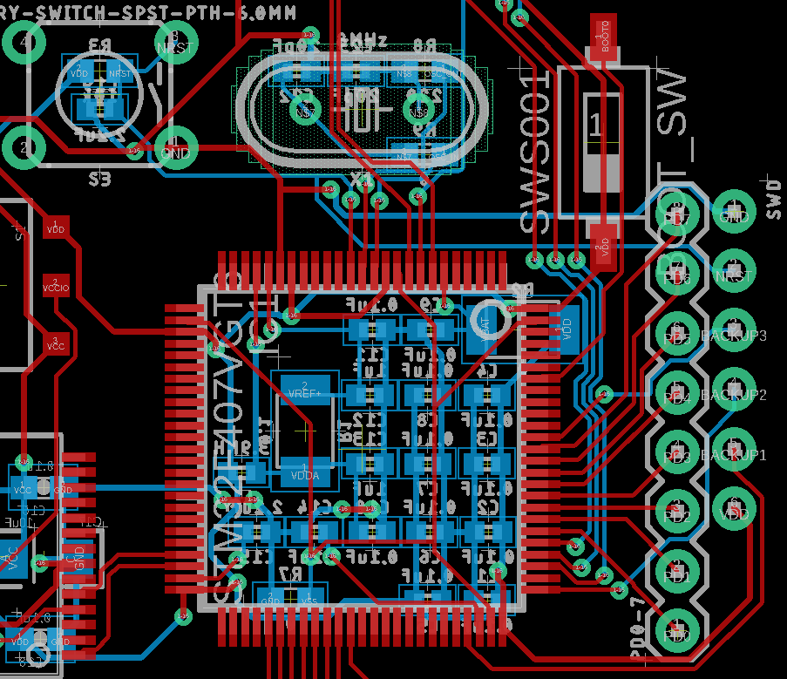
PCB LAYOUT
Layout of the Ground Signal Transmitting Board

Slide 24
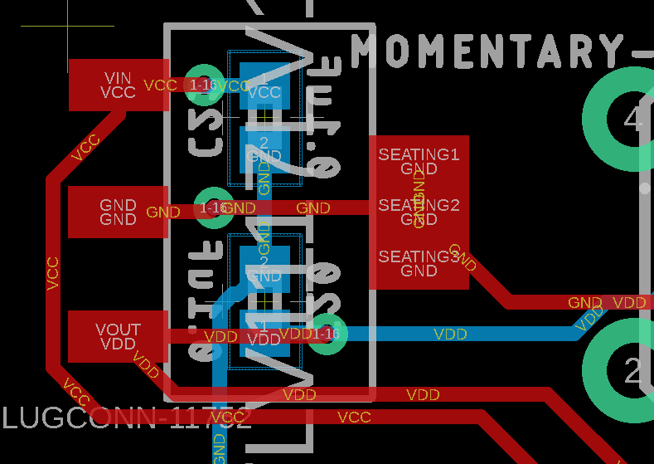
PCB LAYOUT
Layout of the Ground Signal Transmitting Board

Slide 25
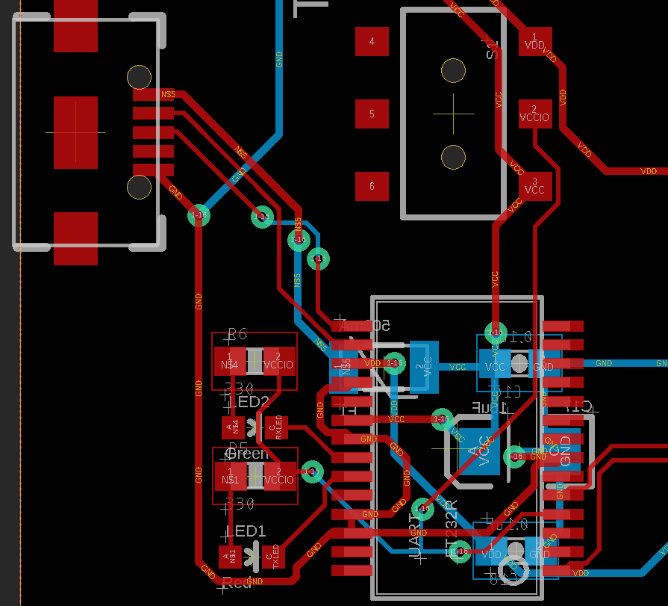
PCB LAYOUT
Layout of the Ground Signal Transmitting Board

Slide 26
PROTOTYPING PROGRESS
Overview
Our project mainly involves the following interfacing:
UART
RF Module
Gimbal
Flight control

Slide 27
PROTOTYPING PROGRESS
UART Module
What has been done:
verified UART working, capable of sending and receiving data
verified UART can be used to program the microcontroller with via STM32’s bootloader

Slide 28
PROTOTYPING PROGRESS
RF Module
What has been done:
Successfully interfaced the nRF24L01+ module with STM32
verified data sending and receiving by sending sample data and print on terminal via UART
To Do:
Test IRQ
Test signal range and latency

Slide 29
PROTOTYPING PROGRESS
Gimbal
What has been done:
selected and flashed firmware on the gimbal controller
verified the gimbal is working
interfaced gimbal controller with our microcontroller (STM32) and verified the 3-axis movement of the gimbal can be controlled by the microcontroller using 2 DAC channels and 1 PWM channel + low-pass filter
To Do:
implement software to let the gimbal point at desired human face.

Slide 30
PROTOTYPING PROGRESS
Flight Controller
What has been done:
committed research on how to modulate PPM signals which is supposed to use for interfacing with the flight controller
set up timer with interrupt as the first step to modulate PPM signals
Modulated PPM signal
To Do:
test latency
implement failsafe

Slide 31
SOFTWARE DEVELOPMENT STATUS
Ground Station
Image Processing Module (Completed)
Acquire video information from a RF receiver
Facial Landmark analysis
Control Signal Process
UART Module (In development)
Acquire control signal and send to microcontroller through UART
GUI application (Prototype)
Live monitor and face selection

Slide 32
SOFTWARE DEVELOPMENT STATUS
Embedded Firmware
The Embedded Firmware is separated into two parts.
Ground station transmitter firmware
On-drone receiver & controller firmware

Slide 33
SOFTWARE DEVELOPMENT STATUS
Embedded Firmware: Ground station transmitter
The ground station transmitter has two main responsibilities:
Get data from Ground Station through UART (Prototyped)
Send data to the on-drone receiver & controller (Prototyped)

Slide 34
SOFTWARE DEVELOPMENT STATUS
Embedded Firmware: On-Drone receiver & controller
The on-drone receiver three main responsibilities:
Receive data from transmitter (Prototyped)
Modulate PPM using data received (Prototyped)
Implement fail safe & main logic (In Progress)

Slide 35
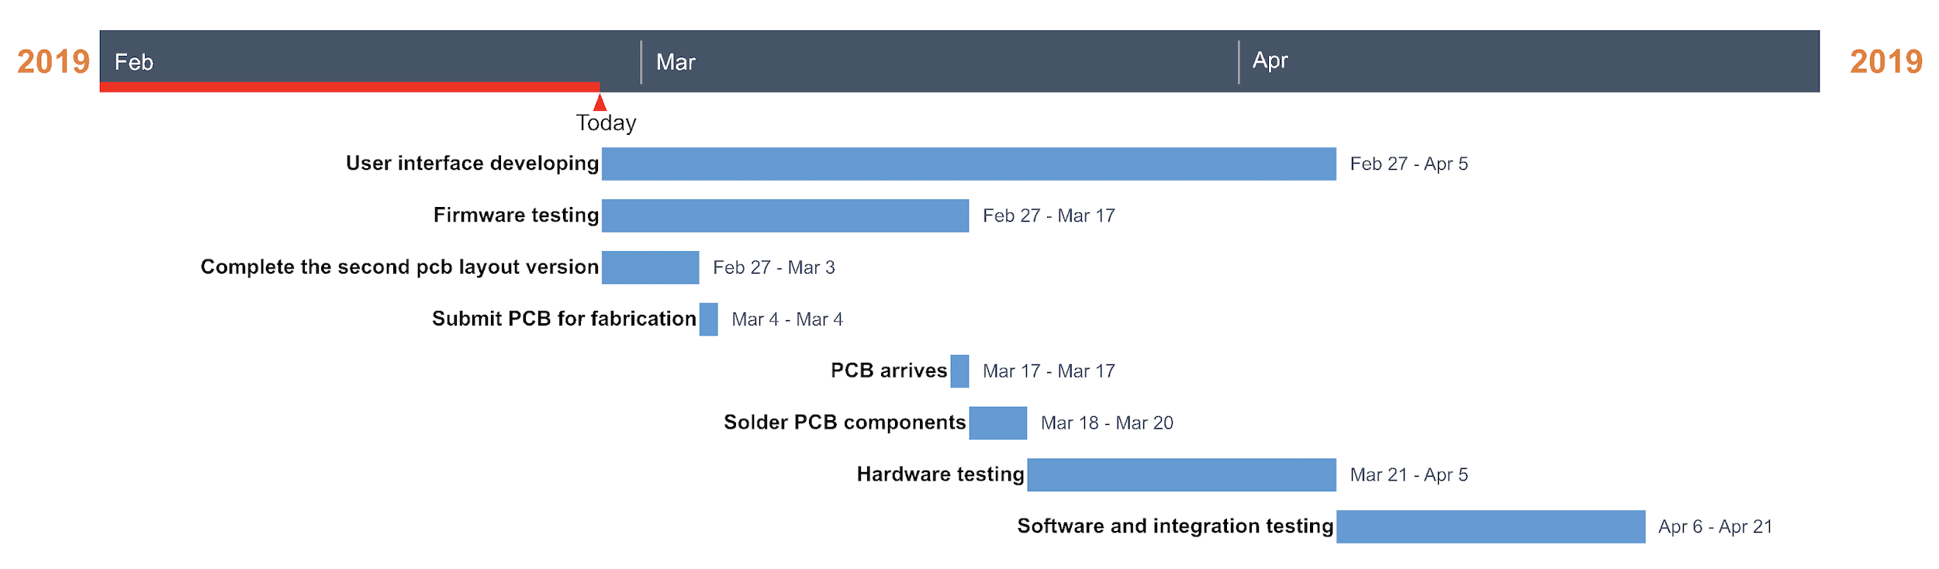
PROJECT TIMELINE

Slide 36
3D PRINTING
Questions?

